Slide 1

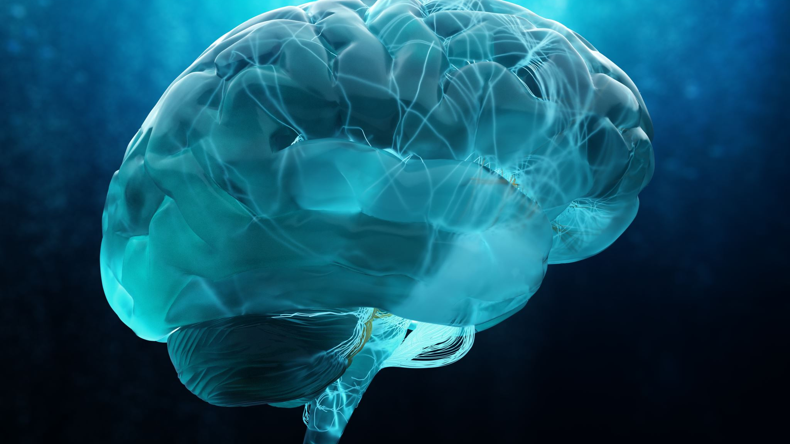
ML 24/25-01 Investigate Image Reconstruction By using Classifier
Team: Binge_Coders
Rajan Singh
Pradeep Tiwari
Mausam Bhunia

Slide 2
Introduction
Image Binarization
KNN and HTM Classification
Spatial Pooler
Reconstruction
Similarity Calculation

Slide 3
Objective
The objective of this study is to reconstruct images using Hierarchical Temporal Memory (HTM) networks and K-Nearest Neighbors (KNN) through the NeoCortex API's Reconstruct method. Specifically, the study aims to:
Reconstruction Method in NeoCortex API
Perform Image Binarization for Preprocessing
Execute the Reconstruction Process using HTM and KNN
Evaluate Reconstruction Accuracy by Measuring Similarity Between Original and Reconstructed Inputs

Slide 4

NeoCortexAPI is a framework for implementing Hierarchical Temporal Memory (HTM) and Sparse Distributed Representations (SDRs) in machine learning applications. Spatial Pooler (SP): This algorithm learns spatial patterns by identifying and reinforcing active synapses in response to input data, creating stable representations for similar inputs. Spatial Pooler, Temporal Memory (TM) , Encoders, Cortical Network Algorithms are some of the key components.

Slide 5
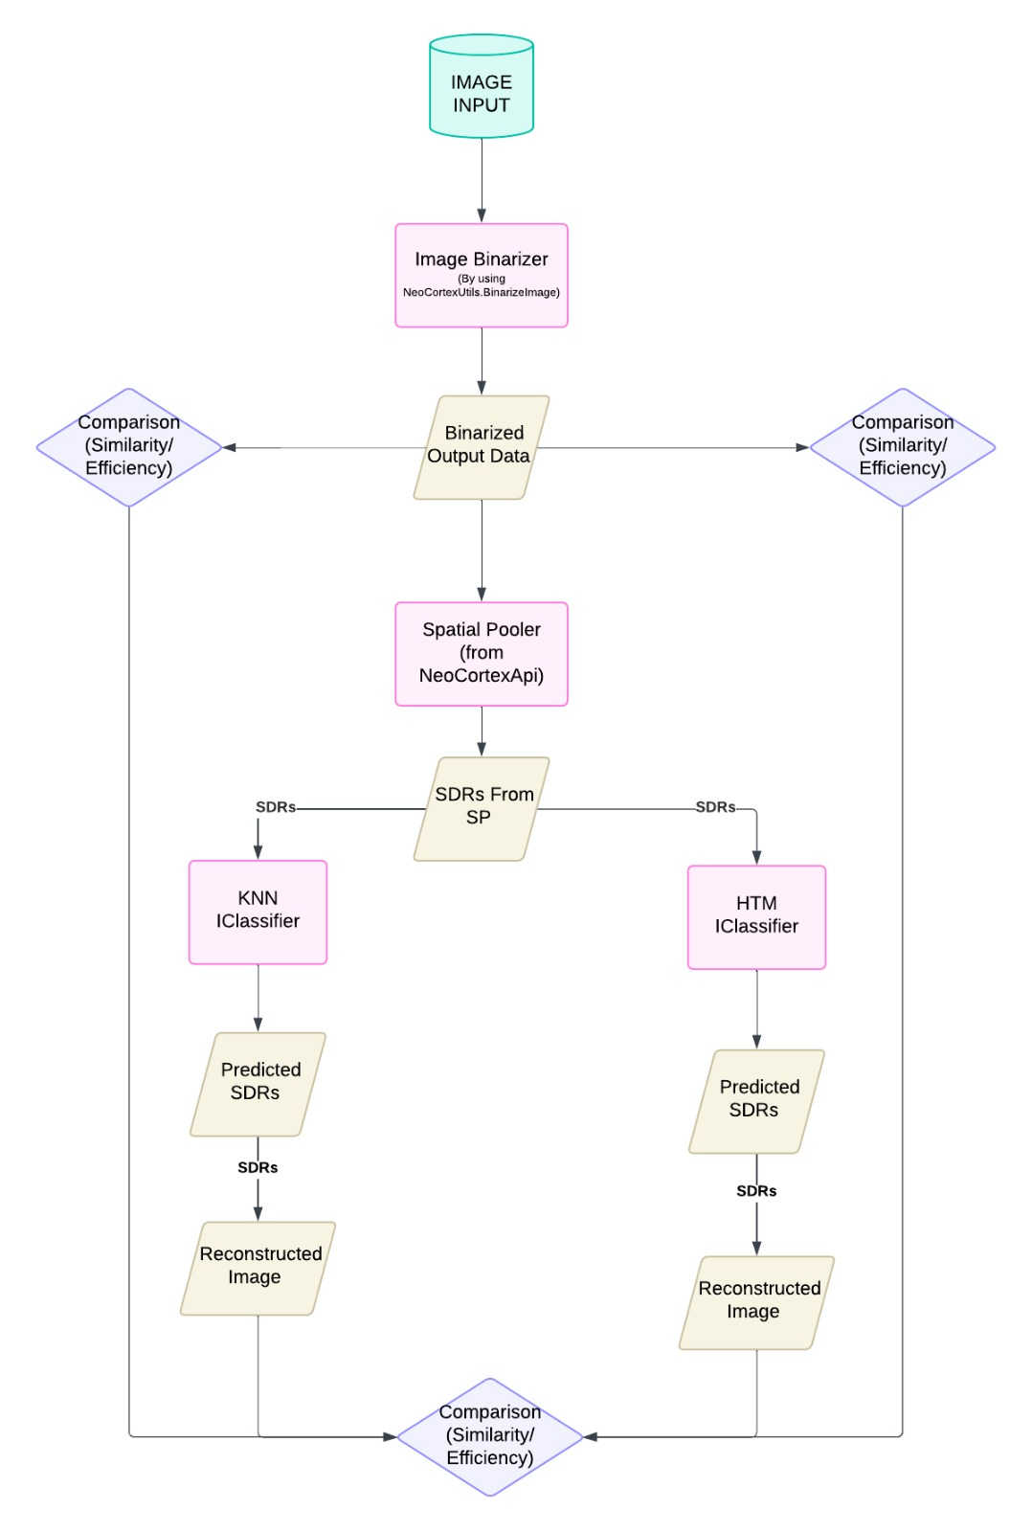
Methodology
The proposed methodology involves transforming input images into Sparse Distributed Representations (SDRs), predicting SDRs using classifiers, reconstructing images, and evaluating their efficiency.

Slide 6
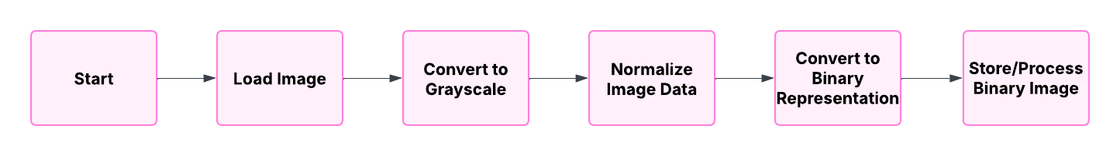
Image Binarization

Slide 7
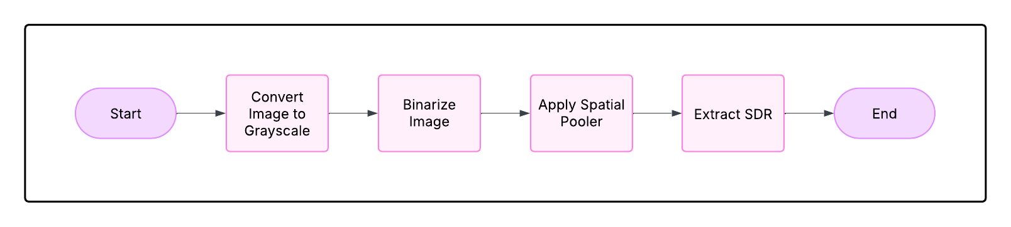
Spatial pooler- Extracting SDRs

Slide 8
HTM (Hierarchical Temporal Memory) Classifier
Inspired by the neocortex, HTM learns temporal patterns and makes predictions based on sequences.
Uses sparse distributed representations (SDRs) for robust recognition and anomaly detection.
Suitable for streaming data and sequential learning.
KNN (K-Nearest Neighbors) Classifier
A simple, instance-based learning algorithm that classifies data based on similarity to its nearest neighbors.
Does not require a training phase but depends on distance metrics (e.g., Euclidean, Cosine).
Effective for pattern recognition but computationally expensive for large datasets.
What are HTM and KNN Classifiers

Slide 9
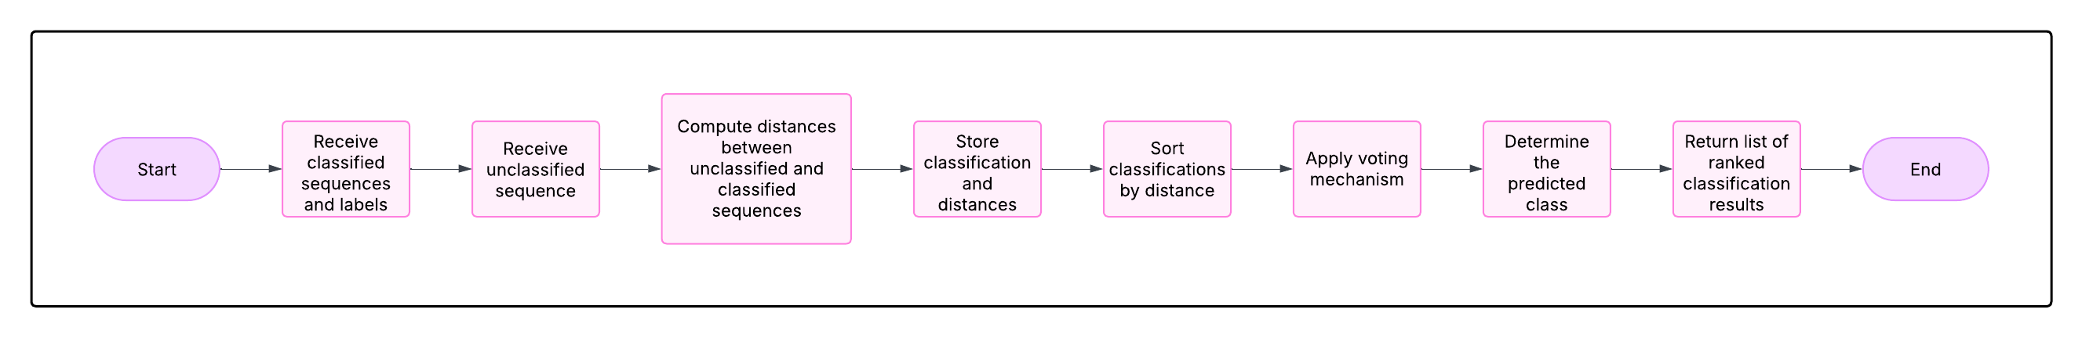
KNN Classifier

Slide 10
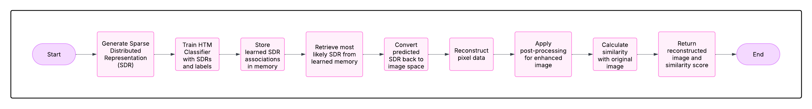
HTM Classifier

Slide 11
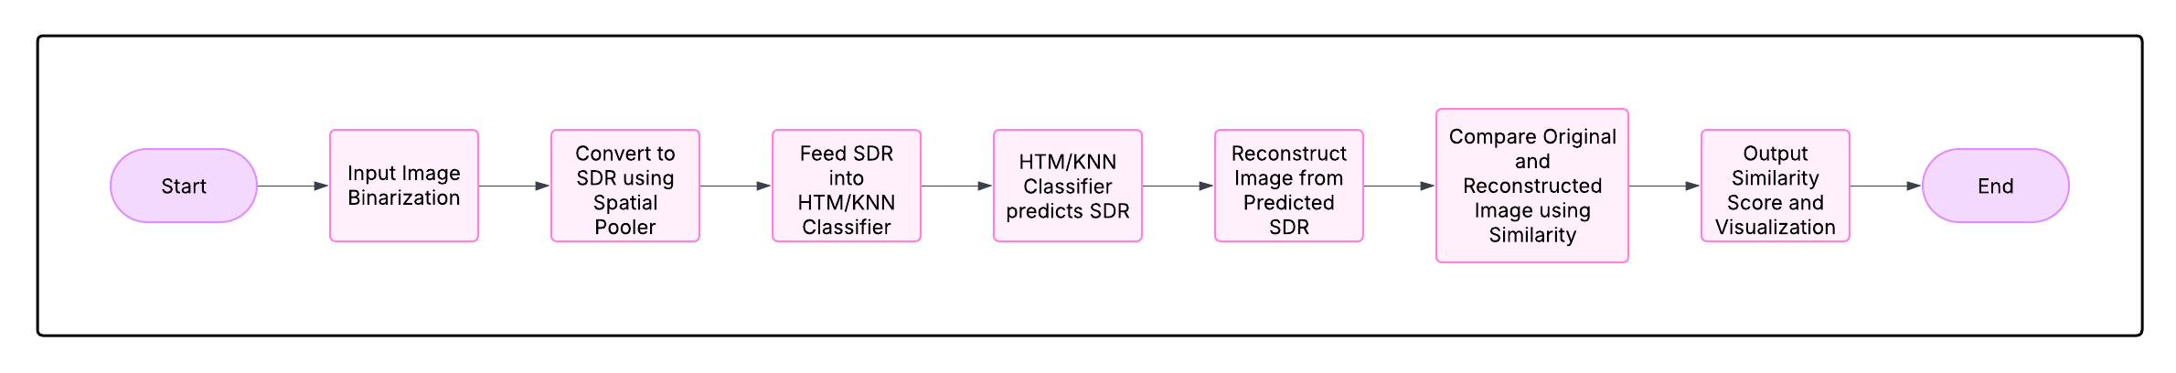
Image Reconstruction using Classifiers.

Slide 12
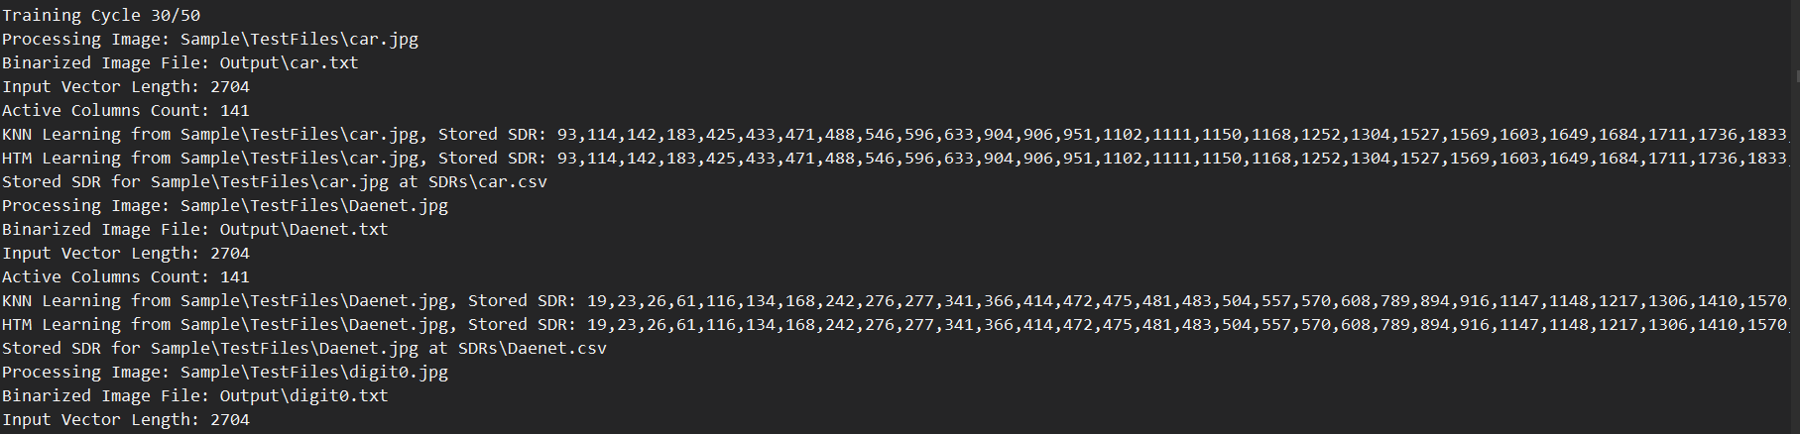
SDR’s generated for multiple Images for different cycles

Slide 13
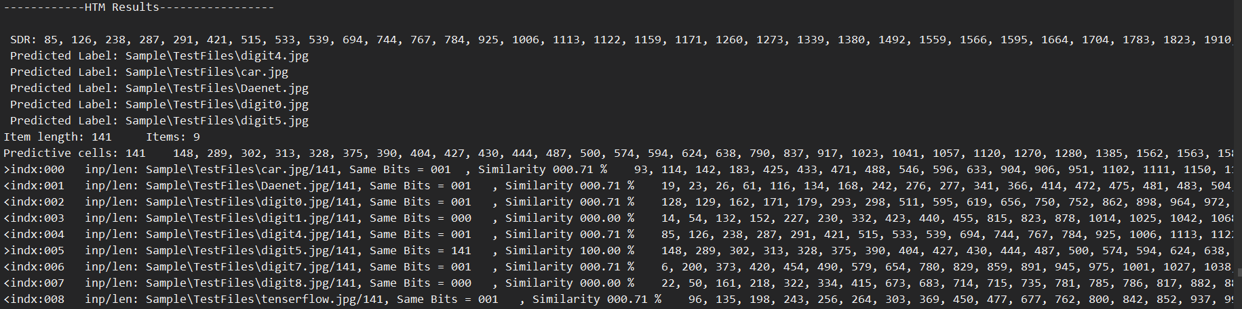
SDR’s generated by HTM Classifiers-
SDR’s generated by KNN Classifiers-

Slide 14
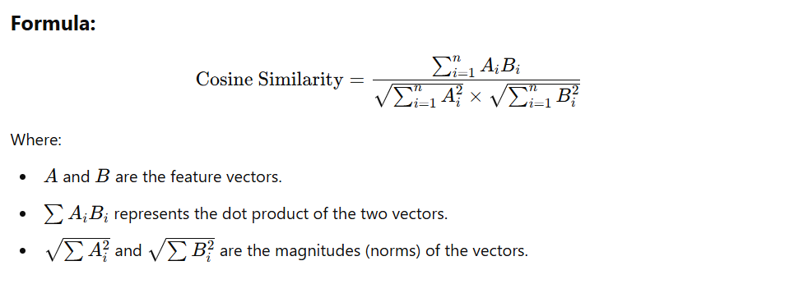
Cosine Similarity
Cosine Similarity is a method used to quantify how similar two vectors are by computing the cosine of the angle between them. It is widely applied in machine learning, text analysis, and image processing to compare feature representations.
Applications:
Text Similarity: Used in NLP for document comparison (e.g., TF-IDF feature vectors).
Image Processing: Helps compare feature vectors extracted from images.
Recommendation Systems: Identifies similar users or items based on preferences.

Slide 15
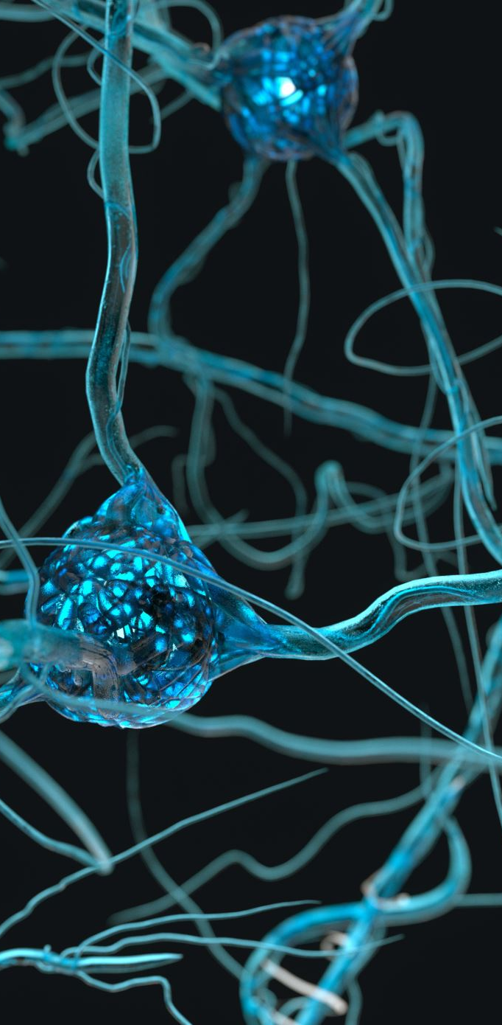
Permanence values are the connections between cells or neurons in a network, representing the strength of a synapse. These values are crucial in determining how well a synapse can activate a neuron and are key to the learning process within HTM. Permanence values are usually set between 0 and 1 (e.g., 0.2 to 0.8), where values close to 1 indicate strong, stable synaptic connections, and values closer to 0 indicate weak or non-existent connections.
If a synapse isn't used or becomes irrelevant, its permanence value is decreased, eventually pruning the synapse. This allows HTM to adapt to changes in input patterns.
The processed binarized images are fed into the spatial pooler, where each image input (in the form of SDRs) will activate specific columns in the pool. The permanence values here will control how strong or weak the synapses are between cells and how much influence each input has on the column.
Learn Image Structure: For multiple images, the permanence values will adjust so that cells representing common features in the images (e.g., edges, shapes) have stronger synapses. This enables the system to recognize those features more easily.
Permanance Values

Slide 16
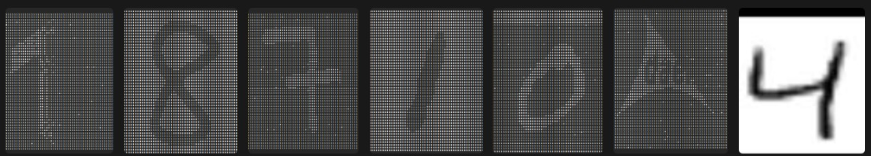

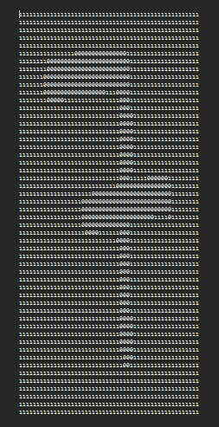
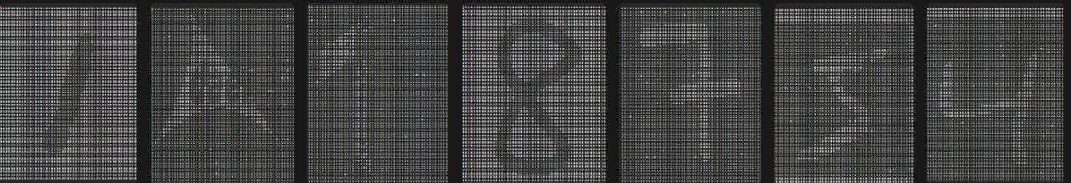
Image Reconstruction using Classifiers.
Reconstruction of Image using KNN
Image Binarization Process
Reconstruction of Image using HTM

Slide 17
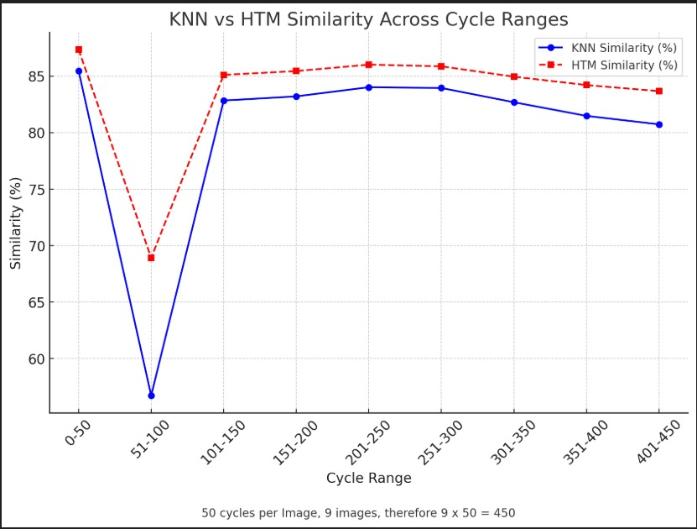
Similarity Analysis of KNN vs. HTM Classifiers
HTM outperforms KNN in similarity percentage
HTM Similarity: 83.51% (on average)
KNN Similarity: 80.12% (on average)

Slide 18
KNN vs. HTM Classifiers
KNN, a distance-based classifier, retrieves the closest match from the training dataset, aiding direct pattern reconstruction.
HTM, inspired by biological intelligence, learns spatial patterns and continuously adapts over time.

Slide 19
The combination of Sparse Distributed Representations (SDRs) and the Neocortex (HTM – Hierarchical Temporal Memory) allows for a biologically inspired way of recognizing and classifying images. Unlike traditional deep learning models, this method mimics how the human brain processes visual data.
Real Life examples
Image reconstruction plays a crucial role in several practical applications. Below are some of them,
Satellite Image Processing: Reconstructing missing or corrupted parts of satellite images due to cloud cover or transmission errors.
Example: Used in weather forecasting, agriculture, and disaster response.
Super-Resolution & Denoising (Photography & Video) : Enhancing low-resolution images using AI models.
Example: Removing noise from security footage to identify objects better.

Slide 20

Thank you!

